Slide 1

CS 328 - Fall 2020
Assignment 3:
Image classification

Slide 2
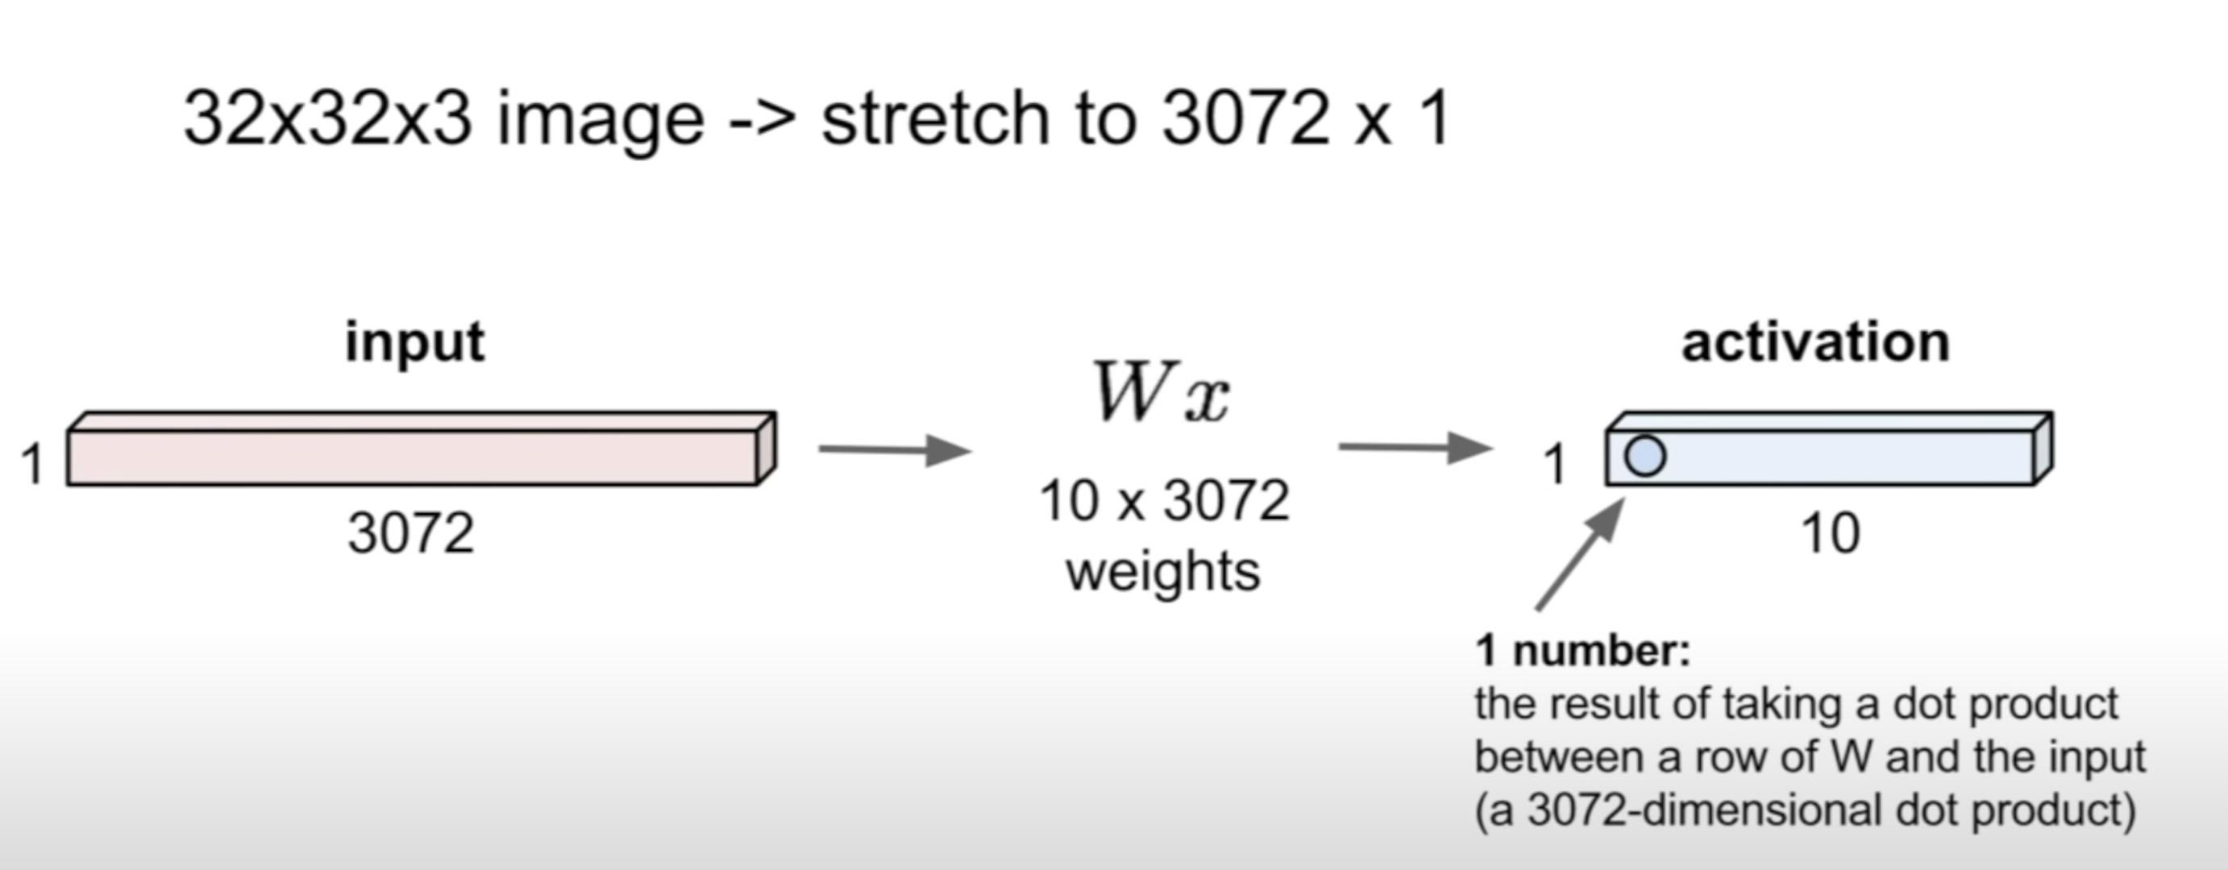
Fully Connected Layer:
Flatten 2D/ 3D input and multiply by weights
Specify number of input and output neurons
http://cs231n.stanford.edu/slides/2017/cs231n_2017_lecture5.pdf

Slide 3
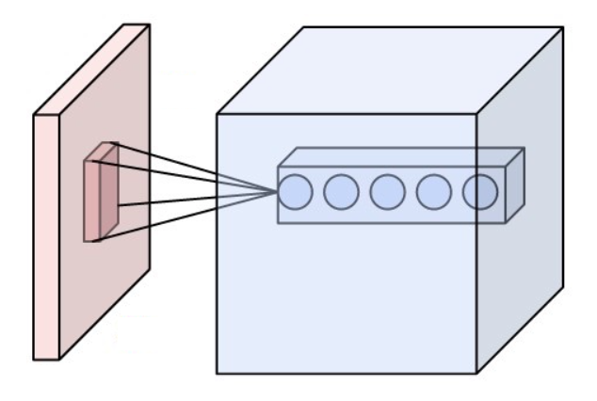
Convolution Layer:
A kernel sliding over 2D input, doing element-wise multiplication, adding to an output pixel
Input/output channels
Padding: padding edges with extra zeros to keep the size
Stride: specifies how many pixels to skip at each slide
http://cs231n.github.io/convolutional-networks/
Q: why would we prefer CNN over Fully-Connected layers?
Notes:
Paramater sharing

Slide 4
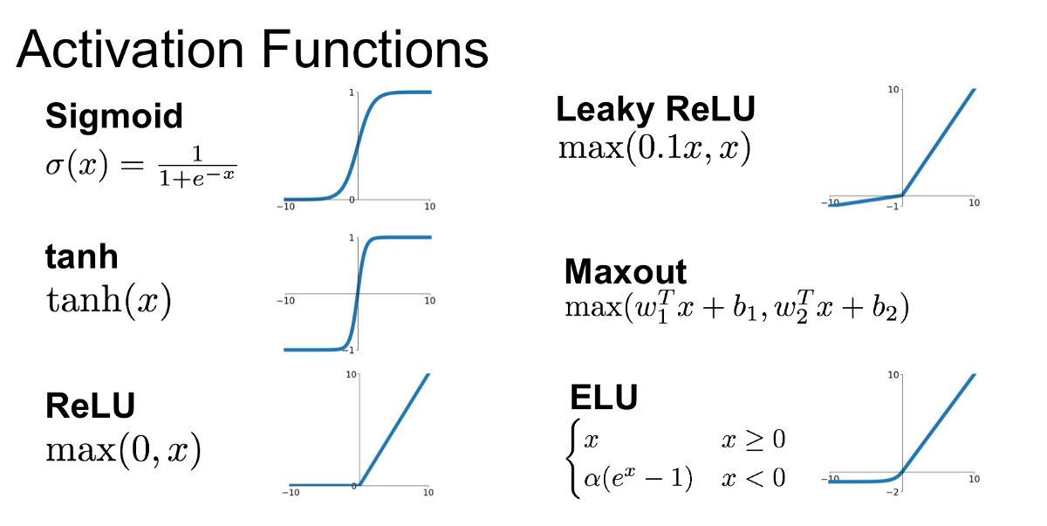
Notes:
To introduce non-linearty

Slide 5
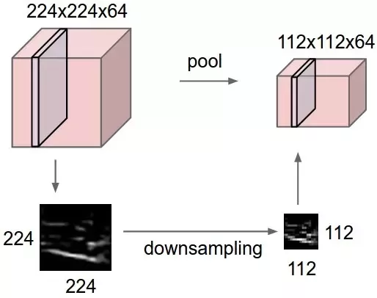
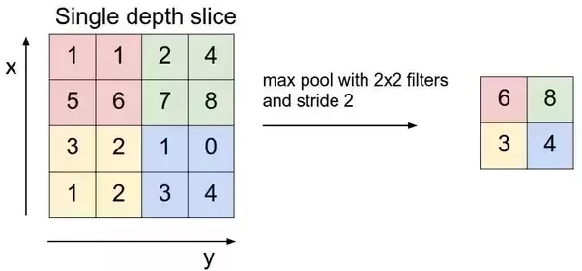
MaxPooling:
https://www.quora.com/What-is-max-pooling-in-convolutional-neural-networks

Slide 6
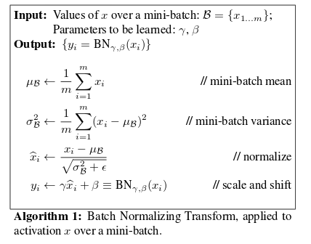
BatchNorm:
Batch normalization normalizes the output of the previous layer by subtracting the batch mean and dividing by the batch standard deviation.
It adds two trainable parameters to each layer
Effect: adds some regularization so it reduces overfitting and accelerates the training too.

Slide 7
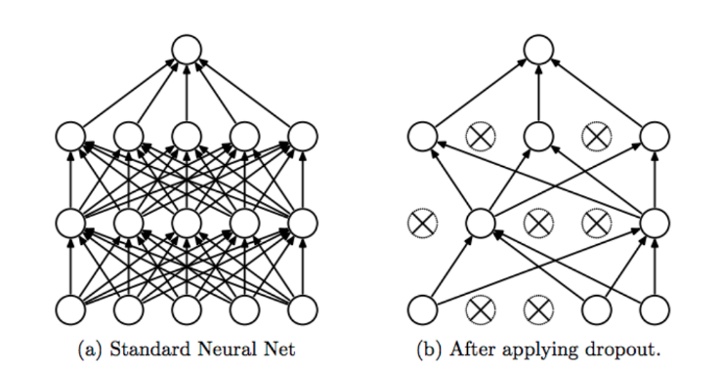
Dropout:
Ignore a factor of nodes in the training phase
Effect: learns more robust features but takes longer to converge, also a regularization technique.
Set the keep rate, where 1.0 means no dropout, and 0.0 means no outputs from the layer.

Slide 8
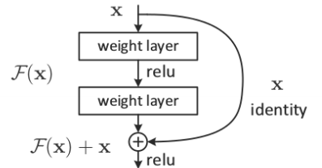
Skip-Connections:
This is the building block of ResNet, where n each layer feeds into the next layer and directly into the layers about 2–3 away.
Re-captures features/information from the earlier layers
Solves the vanishing gradient problem

Slide 9
Dataset

Slide 10
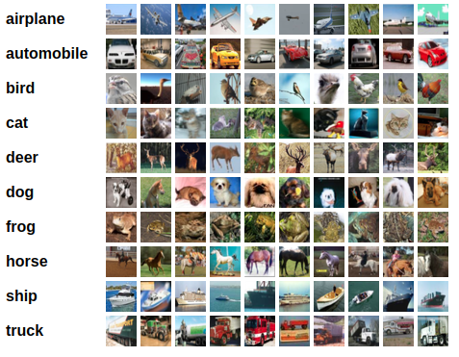
CIFAR-10 Dataset
32x32 RGB images of different objects
60000 in 10 classes, with 6000 images per class, divided as 50000 training images and 10000 test images.

Slide 11
Different Data splits:
Train Data (45,000)
Validation Data (5,000): Last 10% of the training data
Test Data: Shouldn’t be included in the training process, even for fine-tuning the hyperparameters

Slide 12
Implementation Steps:
Define your train, validation, and test data loaders in load_dataset function
Define your model, satisfying all the requirements stated
Define loss and optimizer
Try different loss functions + different optimization techniques [optional]
You may add weight regularization to the loss
You may initialize model weights using Xavier initialization
Implement the training loop + validation, save your best model checkpoint based on the validation accuracy
Test your model on the test-set

Slide 13
Useful PyTorch functions:
Optimizer: Adam, SGD, etc:
torch.nn.CrossEntropyLoss
Data Loader : torchvision.datasets.CIFAR10
Data Samplers
Conv, fully connected layer, activation functions
Reference: https://pytorch.org/tutorials/beginner/blitz/neural_networks_tutorial.html

